Slide 1
Gender equality and the parité debate.

Slide 2
Women in French politics
2019: Women represent 52.3% of French electorate (HCE, 2020)
Right to vote: 1944 (1848 for men)
Until end of the 1980s, France had been one of the European countries with the lowest rate of participation of women in political assemblies (11% in the National Assembly, 5% in the Senate, 7% of the mayors; one woman out of the 104 Presidents of departmental Assemblies).
National Assembly:
October 1945: 33 women elected to National Assembly, out of 586 MPs. 5,6% of total.
2017 Legislative elections: 38.7% of MPs were women (224/577) up from 26,9% in 2012.
Representative of broader gender-based discriminations in French society (salaries, top management positions...)

Slide 3
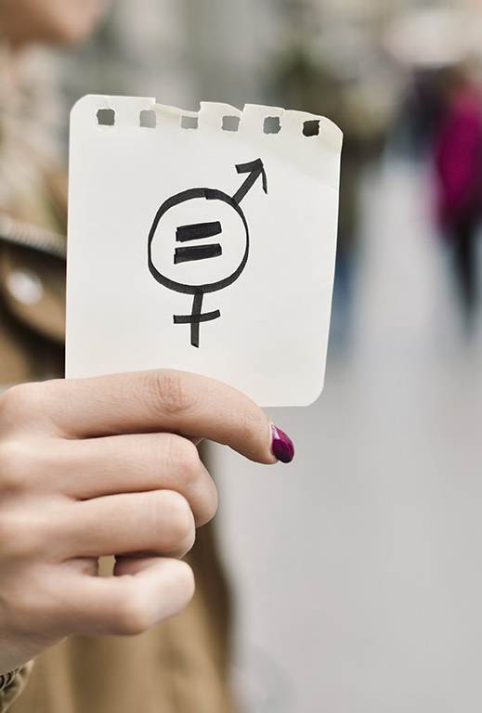
Parité campaign
1990s: within a decade and following intense campaign, France implemented an affirmative action policy to help women gain political representation (mandated by a constitutional amendment in 1999 and an electoral law in 2000)
The amendment adds following sentence to the article on sovereignty: “The law promotes equal access of women and men to electoral mandates and elective offices.”
Another sentence has been added to the constitutional article concerning political parties: “They contribute to the implementation of [this] principle.”
How did parité go, in less than a decade, from being a utopian demand to a consensual reform?

Slide 4
A brief history (1)
1982: Under first French Left-wing government in the Fifth Republic, National Assembly voted a law stating that no party list in municipal elections shall consist of more than 75% of candidates of the same sex.
Conseil Constitutionnel objected that this law was not constitutional referring to
Declaration of the Rights of Man and of the Citizen (which has a constitutional value in the French system) which states: “As all citizens are equal in the eye of the law, positions of high rank, public office and employment are open to all on an equal basis according to ability and without any distinction other than that based on their merit or skill”;
Art. 3 of 1958 Constitution: “no group (section) of people, nor any individual, may lay claim to the exercise” of National Sovereignty.
Only solution therefore is to amend the Constitution.

Slide 5
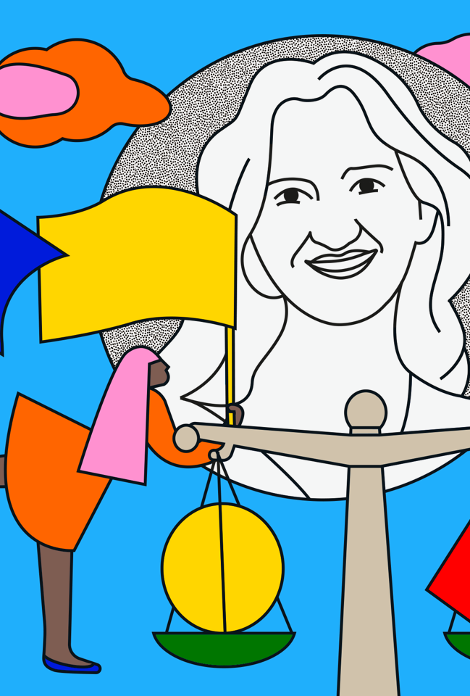
A brief history (2)
Green and Alternative political group (‘Arc-en-Ciel’) introduced notion of ‘parité’ and decided to implement an internal quota of 50% women in most of the leading positions.
Green Party also implements this principle
Concept taken up by most feminist organisations that popularized it at the beginning of the nineties.
1992: Au Pouvoir Citoyennes! Liberté, égalité, parité (Françoise Gaspard, Claude Servan-Schreiber, Anne Le Galle): introduces concept to wider French public
November 1993: 577 people published a Manifesto in the newspaper Le Monde arguing for the adoption of a law demanding equal participation of men and women in political assemblies.

Slide 6
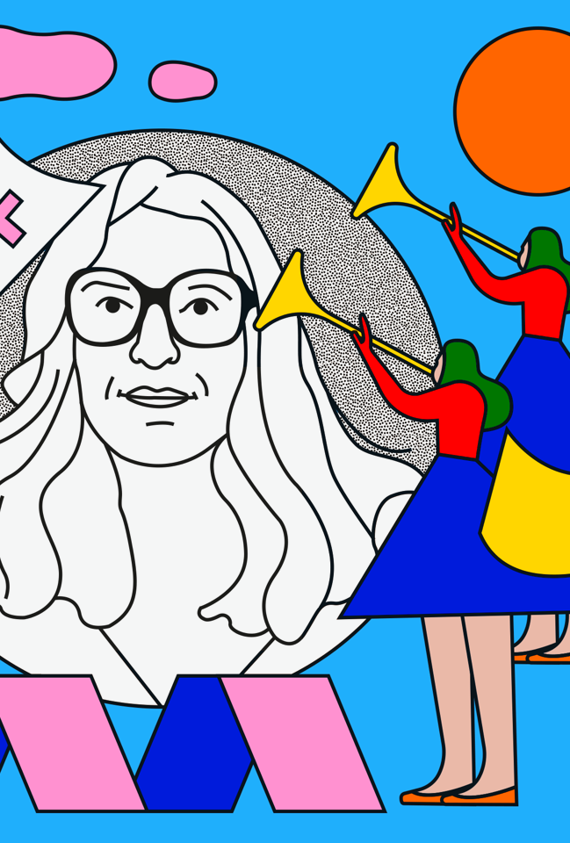
A brief history (3)
At the European level:
1989: Council of Europe established a working group on ‘parity democracy’ and over the following years adopted several recommendations on equal representation in political life.
2-3 November 1992: Conference 'Women in political power' in Athens (funded by European Commission)
“Democracy imposes parity in the representation and in the administration of nations.”
Catalyzing effect on French movement but still minority issue.

Slide 7
A brief history (4)
Shift in the French political context
Defeats of socialist and right-wing governments in 1993 and 1997
Parties are weakened and in state of crisis
Series of bribery scandals ('affaires’)
Opinion polls show high level of distrust towards (predominantly male) politicians.
Jacques Chirac (right) and Lionel Jospin (left) become advocates of “modernisation of political life”: reduce the gap between politicians and citizens.
1995: President Chirac creates a ‘Committee on Parity’
Legislative elections of 1997: Jospin imposes a quota of 30% female candidates on the Socialist Party, resulting in significant electoral success.

Slide 8
A brief history (5)
Bipartisan issue.
Range of groups are set up: Assemblée des femmes, Parité 2000, Parité-Infos, Elles Aussi, Demain la Parité, Réseau Femmes pour la Parité...
Organise conferences, meetings, manifestos, articles...
Growing support from within public opinion.

Slide 9
A brief history (6)
1997: Once elected, Jospin declares that he will revise the Constitution to include amendment on parity.
Constitutional amendment is adopted following one year of intense discussions (and with minor adjustments).
Initial result: During 2001 municipal elections, percentage of women in local councils (in towns with more than 3,500 inhabitants) grew from 25.7% to 47.5%

Slide 10
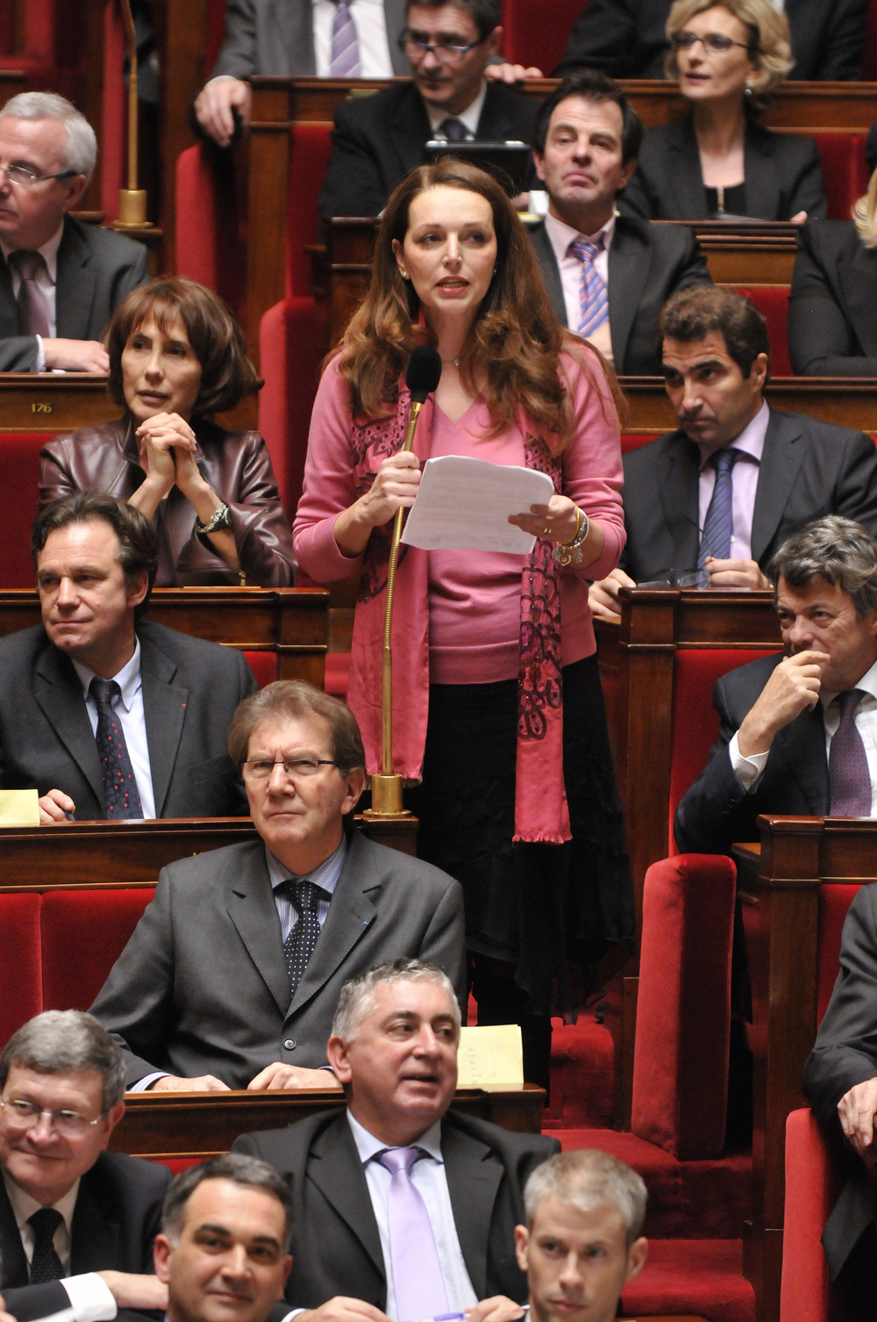
Why adopt such a radical position (to impose parity by law)?
For Sheila Perry and Sue Hart, “the answer lies […] in the extent to which the obstacles were stacked against women gaining power. At every level, social, cultural, historical and institutional, women found their path blocked, unconsciously as well as deliberately, so that nothing short of radical reform was going to solve the problem” (Perry and Hart, 2000:10)
It is the very arguments used against the introduction of quotas which made anything short of parity impossible to get through the male-dominated institutions.
In particular, idea that parity threatened republican universalism.

Slide 11
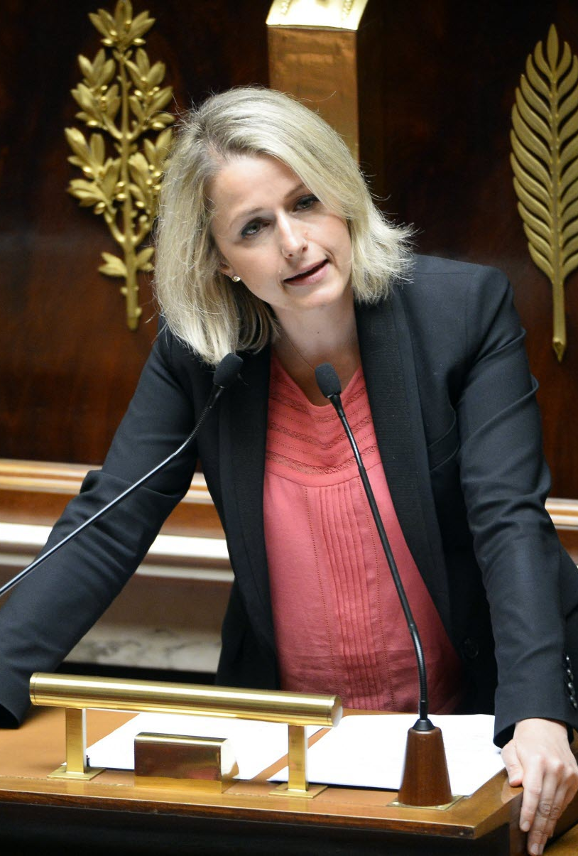
A threat to the Republic?
"[A] peculiar French republican ideology has been the main reason for the French backwardness in political representation of women." (Simon, 2007: 284)
For opponents, parity is presented as a threat to the Republic.
Universalism: all citizens have equal rights, irrespective of social class, religion, race, education or gender.
Only way of protecting universalism is to ensure that citizens remain undifferentiated.
“Because they have rights regardless of gender, then it is dangerous, if those rights are not to be threatened, to lobby for women because they are women, as such action differentiates between citizens” (Perry & Hart, 2000:11).
Differentiation = equated with division. Once distinctions are made on ground of sex then indivisibility of Republic is broken.

Slide 12
A threat to the Republic? (2)
Such argument is made in camp of so-called ‘Universalists’.
Including figures like Elisabeth Badinter: argued against parity in the name of feminism.
Sees in pro-parity movement a dangerous return to essentialism: notion that women are different from men in essence, biologically, from birth – very notion that is used to constrain women to private sphere and exclude them from public life.
“It is by recognizing that masculine and feminine virtues belong to both sexes that we progress towards equality. Humanity is not dual in nature. Each man and each woman is a repository for the whole of humanity.”

Slide 13
A threat to the Republic? (3)
Women were faced with a dilemma:
“They either had to vindicate themselves as women, as sexually different, relying therefore on a category which had been constructed in order to exclude them; or they had to try to gain full citizenship identifying themselves with the other side of the dichotomy, the unencumbered, rational and autonomous citizen, that is, with a figure which had been constructed for men as distinct from women” (Simon, 2007: 284).
Joan Scott (1996), Only paradoxes to offer: French feminists and the Rights of Man:
Tension between two universalisms.
Universalism of ‘abstract’ individual rights vs. Universalism of ‘sexual difference’ (idea that women are different)

Slide 14
A threat to the Republic? (4)
For those in the pro-parity camp:
1789 Revolution and all subsequent regimes until after WW2 gave civil and political rights only to men
Universalism was therefore not gender neutral
Gisèle Halimi: “The universal is, above all, masculine”.
Universalism is a false myth: claims that rights are universal and yet reserves them for men.
“It is necessary to recognize that the human race is both masculine and feminine so that the rights accorded to men can also be extended to women. In other words, the introduction of parity is the only way to make universalism become reality. Universalism as it stands, without parity, claims to make no distinction between men and women but in fact assimilates women to men” (Perry and Hart, 2000: 12).

Slide 15
A threat to the Republic? (5)
Francine Demichel: “Parity alone can take this unilateral identification of one sex with another and replace it with real equality between the sexes.”
Parity = way of properly realizing republican ideals.
Unlike quotas, parity can be claimed in the name of equality (not 20% or 30% representation but equal representation)

Slide 16
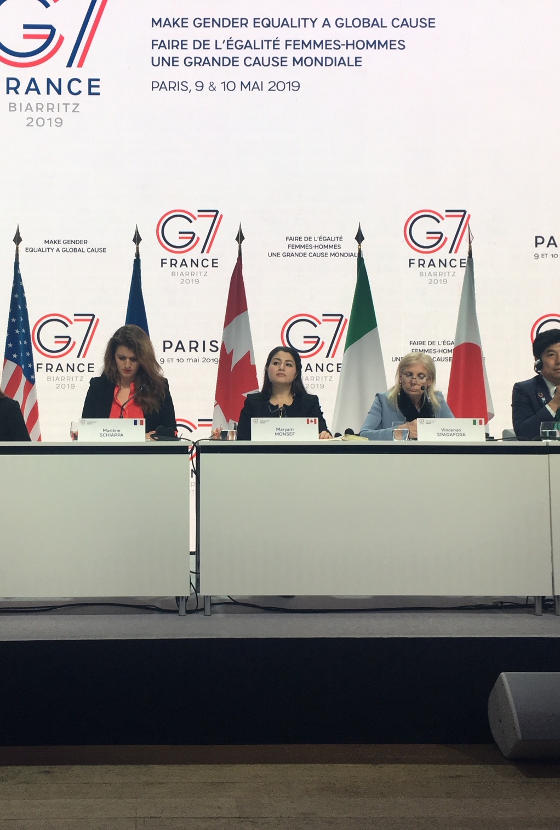
Distinction between quotas and parity
Way of arguing against the accusations of communautarisme.
Parity is demanded on grounds that men and women have equal status, not on grounds that women represent a minority.
For certain proponents: Gender is not to be confused with other categories (ethnicity, religion, age, etc.) as it is the only distinction which exists in roughly equal proportions throughout humanity.

Slide 17
Concluding remarks
Parity debate and other forms of gender discrimination:
“parity seems more appealing when this struggle against a specific and highly crucial discrimination leads not only to a reduction or suppression of this discrimination but to a fight against any form of discrimination” (Simon, 2007:296).
Gender discrimination is not reducible to the political sphere: debate on parity highlighted other kinds of gender discrimination.
However, by highlighting specificity of women (50% of humanity) as opposed to other groups, and compatibility with republican universalism, there is also a risk of undermining other struggles by minority groups.

