Slide 1
Theoretical underpinnings of research (part II): research questions, aims, objectives and conceptual frameworks
BSc Dissertation Module (IPH6102)
Module leader: Giuliano Russo
October 2nd 2020

Slide 2
The link between theory and empirical evidence when conducting research
Research works on two level: empirical observations, and theory building
One cannot live without the other; theory on its own would not be ‘falsifiable’, and observations on their own would not be generalisable or explain wider phenomena
This is why before setting out for a piece of research, we need to identify the relevant research questions, and study objectives
We also need a ‘conceptual framework’, explaining our understanding of the phenomenon, but also telling us what data (observations) are needed to verify our hypotheses

Slide 3
Research (dissertation) questions – what the difference with the general aim?
A dissertation’s aim is what your work sets out to achieve
A research question is the fundamental core of a research project, study, or review of literature. It spells out the question you want to answer through your research, focuses the study, determines the methodology, and guides all stages of inquiry, analysis, and reporting
It starts by identifying a problem, and leads to formulating hypotheses to be tested
Attributes of a (good research question): (a) the question is clear (b) significant; (c) answerable, and (d) ethical

Slide 4
Defining your research question
Imagine you want to know whether the UK govt should make compulsory wearing bicycle helmets; what is the most relevant research question you should ask?

Slide 5
Defining your research question (cont.)
The aim of you research may be to explore whether cyclist should wear helmets
But the questions need to be clear, specific, not too broad, and answerable; e.g. would cyclists get less injuries if they wore a helmet?
Questions need to identify a specific situation, for which the answer is consistently the same, e.g. helmets protect against injuries, unless you are a reckless driver….
A good research question would be: ‘Was wearing a bicycle helmet in London associated with a smaller probability of traffic injuries in the last decade?’

Slide 6
Good and bad research questions
Are female students smarter than male ones? What is wrong with this question?
Are final year BSc female students’ dissertation’s grades higher than their male peers’ ones?
Can AIDS patients run 100 metres in less than 13 seconds? What is wrong with this question?
To what extent is the mobility of HIV-AIDS patients affected after two years of ART treatment?

Slide 7
What are a dissertation (research) aims and objectives?
Aims: general purpose of the dissertation; what do you want to achieve?
→ ‘What to examine?’
Objectives: practical steps that are needed to achieve the aim
→ ‘How to examine?’

Slide 8
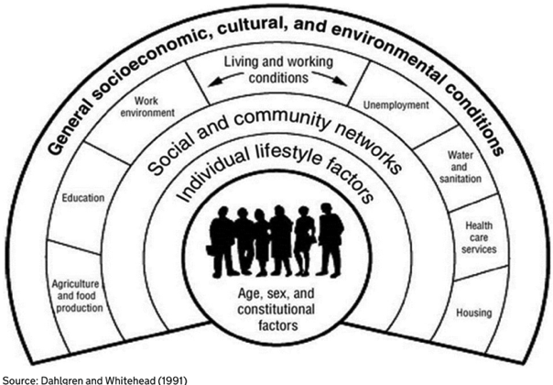
What are conceptual (research) frameworks?

Slide 9
Conceptual frameworks (CF)
CFs are a graphical representation of your understanding of a phenomenon and the causal relations between its components
A CF does not take place in a vacuum, and will always make a reference to the existing theories and evidence on the subject – i.e. what other scholars have said and written about it – its justification
A conceptual framework can be used to explain how you are planning to research the topic, and the areas you will be focussing on
A good CF: (a) gives a comprehensive view of the topic; (b) is linked to the literature and the evidence; (c) gives an idea of causality and sequence of events; (d) helps to operationalise your research/study

Slide 10
A few reasons why having a CF may be useful (Bordage, 2009)
Organising (and explaining) your thoughts
Grounding your dissertation in the literature on the topic
Moving beyond descriptions of ‘what’ to explanations of ‘why’ and ‘how’
A filtering tool for linking research questions to data and data collection methods
A way of linking all the relevant bits of your research – the theoretical underpinnings, the questions, the data
Identifying the boundaries of the work

Slide 11

A framework to understand and research physician dual practice in LMICs
Source: Russo and McPake, 2013

Slide 12
Take away messages
Research questions encapsulate the essence of your research – they need to be ‘answerable’ and focus on a narrow aspect of a a wider problem
Research aims refer to what is that you want to achieve with your investigation
Objectives with the steps your research plans to take to achieve its goals
Conceptual frameworks can show your understanding of the phenomenon to be researched, and how you are planning to research it
They are a way to relate the theoretical aspects of research with its methods

